Slide 1

CHAPTER 5 Concurrency: Mutual Exclusion and Synchronization
Instructor: Wuman LUO
luowuman@ipm.edu.mo
Office: A213
14:30-17:30 Tuesday & Wednesday

Slide 2
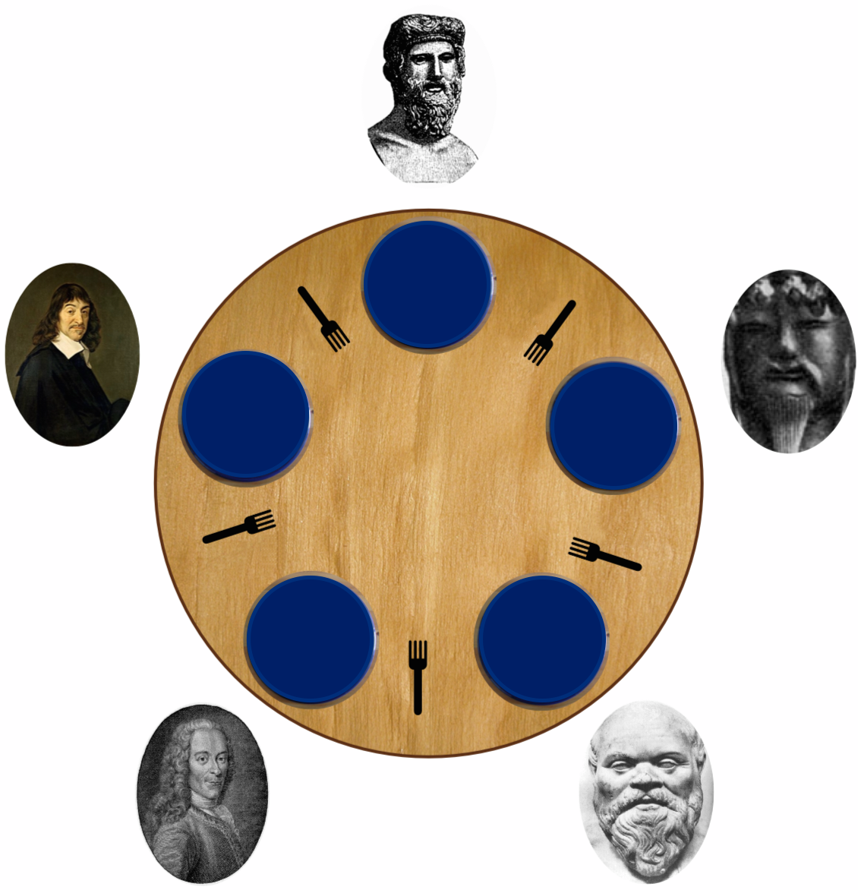
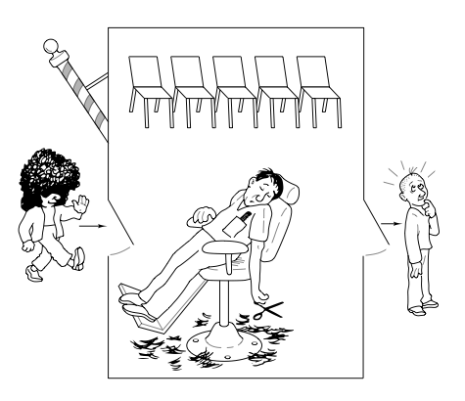

We’ll study…
A wider usage of semaphore: synchronization
How to use semaphore to synchronize multiple threads
Synchronized access to a pool of resources
Producer/Consumer problem
Barbershop problem
Readers/Writers problem
Dining Philosopher problem

Slide 3
Synchronize access to a shared resource
semaphore s
1
shared resource R
// thread 0 while (true) { ... wait(s); acquire R
use it to do sth
release R
signal(s); }
// thread 1 while (true) { ... wait(s); acquire R
use it to do sth
release R
signal(s); }
// thread 2 while (true) { ... wait(s); acquire R
use it to do sth
release R
signal(s); }
The three threads require the same resource R in order to perform an operation. If we have only a single unit of R, we can use the wait(s) and signal(s) to synchronize access to the resource.

Slide 4
Synchronize access to a pool of shared resource
semaphore s
2
shared resource R
// thread 0
while (true) { ... wait(s); acquire R
use it to do sth
release R
signal(s); }
// thread 1 while (true) { ... wait(s); acquire R
use it to do sth
release R
signal(s); }
// thread 2 while (true) { ... wait(s); acquire R
use it to do sth
release R
signal(s); }
⬅
⬅
⬅
Now suppose we have two copies of resource R. At any time, at most two threads can perform the operation. We can allow this by initializing semaphore s to 2 (the number of items R).

Slide 5
Semaphore as condition/event
semaphore music_ready
0
// thread A for network transfer
… download a music file
signal(music_ready);
…
⬅
We can use semaphore to represent a condition or event. One thread may wait( ) for the occurrence of an event, whereas another thread signal( ) the event.
// thread B for playing music
… wait(music_ready);
play the music file
…
⬅

Slide 6
Semaphore as condition/event
semaphore image2display
0
image2display means the number of images downloaded but not yet displayed. If image2display = 0, thread B has to wait.
// thread A for loading image
while (there are more images to download) {
download the next image;
signal(image2display);
}
// thread B for displaying image
while (there are more images to display) {
wait(image2display);
display the next image;
}
Consider the case for a fast download thread v.s. a fast display thread.

Slide 7
Producer/Consumer Problem
Two processes/threads communicate indirectly through the shared buffer
Producer
Produces an item
Appends it to shared buffer, and
Repeats
Consumer
Takes an item from the shared buffer
Consumes it, and
Repeats
Protect the shared buffer, and prevent buffer underflow/overflow
Producer
Consumer

Slide 8
Producer/Consumer Problem
append
take
Consumer
Producer
produce an item and put it in local storage temporarily
move the new item from the local storage to the shared buffer
/* producer */ while (true) { produce(x); append(x,Q); }
/* consumer */ while (true) { take(x,Q); consume(x); }
extract an item from the shared buffer and store it in local storage
consume the item

Slide 9
Protecting Critical Section
Both append( ) and take( ) modify the shared buffer Q. We use a semaphore to protect this critical section.
semaphore s
1
Buffer Q
/* producer */
Item x; while (true) { produce(x); wait(s); append(x, Q); signal(s); }
/* consumer */
Item x; while (true) { wait(s); take(x, Q); signal(s); consume(x); }
We don’t put “produce( )” and “consume( )” inside the critical section. They operate on private, local variable x and so may be executed at the same time.
Notes:
Question: why produce() and consume() are not in the CS?

Slide 10
Buffer Underflow and Overflow
/* producer */ while (true) { produce(x); wait(s); append(x, Q); signal(s); }
/* consumer */ while (true) { wait(s); take(x, Q); signal(s); consume(x); }
If the buffer is full, the producer cannot push an item in. To prevent buffer overflow, he must wait, outside the critical section.
If the buffer is empty, the consumer cannot take an item out. To prevent buffer underflow, he must wait, outside the critical section.

Slide 11
Preventing Buffer Underflow
Producer has just appended an new item to the buffer, so increases n by 1.
If a consumer is waiting for an item, he is waken up.
/* producer */ while (true) { produce; wait(s); append; signal(s); signal(n); }
/* consumer */ while (true) { wait(n); wait(s); take; signal(s); consume; }
If n>0 before calling wait(n), there are items in the buffer. The consumer minus 1 from n and continues.
If n<=0 before calling wait(n), the buffer is empty. The consumer minus 1 from n and blocks himself.
Semaphore n: n>0: number of items in the buffer
n=0: no items in the buffer, no consumer waiting
n<0: no items in the buffer, |n| consumers waiting.
Notes:
Is this a synchronization problem or a critical section problem?

Slide 12
Semaphore n
After appending an item, the number of items is increased by one. So the producer has to signal(n). Also, this will wake up a sleeping consumer, if any.
/* producer */ while (true) { produce; wait(s); append; signal(s); signal(n); }
/* consumer */ while (true) { wait(n); wait(s); take; signal(s); consume; }
In what case does a consumer has to wait before taking an item?
He has to wait if the number of items in the buffer equals 0.
Semaphore n: n: number of items in the buffer

Slide 13
wait(n) in Consumer
/* consumer */ while (true) { wait(n); wait(s); take; signal(s); consume; }
If n>0 before calling wait(n), there are items in the buffer. The consumer minus 1 from n and continues.
If n<=0 before calling wait(n), the buffer is empty. The consumer minus 1 from n and blocks himself.
void wait (semaphore &s) { s.count = s.count -1; if (s.count < 0) {
place this thread in s.queue; block this thread }
}
Semaphore n: n>0: number of items in the buffer
n=0: no items in the buffer, no consumer waiting
n<0: no items in the buffer, |n| consumers waiting.

Slide 14
signal(n) in Producer
Producer has just appended an new item to the buffer, so increases n by 1.
If a consumer is waiting for an item, he is waken up.
/* producer */ while (true) { produce; wait(s); append; signal(s); signal(n); }
void signal (semaphore &s) { s.count = s.count + 1; if (s.count <= 0) {
remove a thread T from s.queue; place thread T on ready queue; }
}
Semaphore n: n>0: number of items in the buffer
n=0: no items in the buffer, no consumer waiting
n<0: no items in the buffer, |n| consumers waiting.

Slide 15
Producer/Consumer – Infinite Buffer
s
1
n
0
buffer Q
/* producer */
Item x; while (true) { produce(x);
wait(s); append(x, Q); signal(s); signal(n); }
/* consumer */
Item x; while (true) { wait(n); wait(s); take(x, Q); signal(s);
consume(s); }

Slide 16
Preventing Buffer Overflow
Before appending a new item into the buffer, the producer must wait for an empty slot. If there is no empty slot, he is blocked.
/* producer */ while (true) { produce;
wait(e); wait(s); append; signal(s); signal(n); }
/* consumer */ while (true) { wait(n); wait(s); take; signal(s);
signal(e); consume; }
After consuming one item, there is one more empty slot in the buffer.
So the consumer add 1 to e.
If there is a producer waiting for an empty slot, wake him up.
Semaphore e: number of empty slots in the buffer
Exercise: what’s the meaning of e=0 and e<0?

Slide 17
Producer/Consumer problem – Summary
Each producer is a thread
Each consumer is a thread
Producers and consumers modify the shared buffer, protected by critical section
Producer has to wait for empty slot (semaphore e)
Consumer has to wait for available item (semaphore n)

Slide 18
Producer/Consumer Problem – Solution
Three semaphores: s
1
n
0
e
N
A buffer Q of size N
(initially empty)
/* consumer */
Item x; while (true) { wait(n); wait(s); take(x, Q); signal(s);
signal(e); consume(x); }
/* producer */
Item x; while (true) { produce(x);
wait(e); wait(s); append(x, Q); signal(s); signal(n); }

Slide 19
Producer/Consumer Problem – Solution
void consumer ( ) {
Item x; while (true) { wait(n); wait(s); take(x, Q); signal(s);
signal(e); consume(s); }
}
void producer ( ) {
Item x; while (true) { produce(x);
wait(e); wait(s); append(x, Q); signal(s); signal(n); }
}
semaphore s = 1;
semaphore n = 0;
semaphore e = N;
Item Q [N];
void main ( ) {
parbegin
consumer(); ..
producer(); ..
parend;
}
In assignments and tests, we will denote a multithread program in this way. Each function call inside parbegin and parend is executed by a new thread.
Notes:
Mention: correct consume(s) to consume(x)

Slide 20
Monitors
Monitor is a software module
Chief characteristics
Local data variables are accessible only by the monitor
Process enters monitor by invoking one of its procedures / methods
Only one process / thread may be executing in the monitor at a time
Notes:
Semaphores provide a primitive yet powerful and flexible tool for enforcing mutual exclusion and for coordinating processes. However, as Figure 5.12 suggests, it may be difficult to produce a correct program using semaphores. The difficulty is that semWait and semSignal operations may be scattered throughout a program, and it is not easy to see the overall effect of these operations on the semaphores they affect.
The monitor is a programming language construct that provides equivalent functionality to that of semaphores and that is easier to control. The monitor construct has been implemented in a number of programming languages, including Concurrent Pascal, Pascal-Plus, Modula-2, Modula-3, and Java. It has also been implemented as a program library.
A. Tanenbaum, Modern Operating Systems, 2009, p. 140: The conclusion is that semaphores are too low level (involving OS) and monitors are not usable except in a few programming languages. Also, none of the primitives allow information exchange between machines. Somethings else is needed.

Slide 21
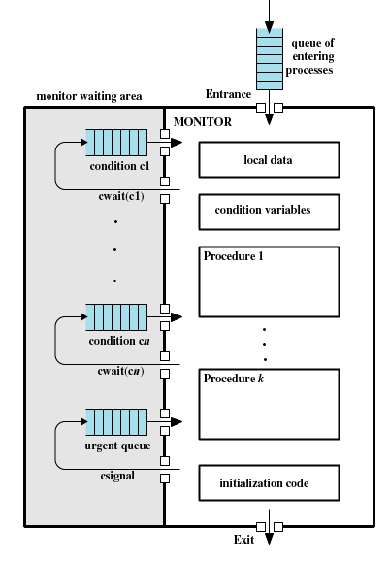
Structure of a Monitor
A process in the monitor
May block itself on condition c by issuing cwait (c)
Be placed in a queue (waiting for c)
Resume execution when c is ready
Detect a change of condition c
Issue csignal(c)
A process waiting for c will be invoked
If there is no process waiting for c, the signal will be lost
Notes:
illustrates the structure of a monitor. Although a process can enter the monitor by invoking any of its procedures, we can think of the monitor as having a single entry point that is guarded so only one process may be in the monitor at a time. Other processes that attempt to enter the monitor join a queue of processes blocked waiting for monitor availability. Once a process is in the monitor, it may temporarily block itself on condition x by issuing cwait (x); it is then placed in a queue of processes waiting to reenter the monitor when the condition changes, and resume execution at the point in its program following the cwait (x) call.
If a process that is executing in the monitor detects a change in the condition variable x, it issues csignal (x), which alerts the corresponding condition queue that the condition has changed.

Slide 22
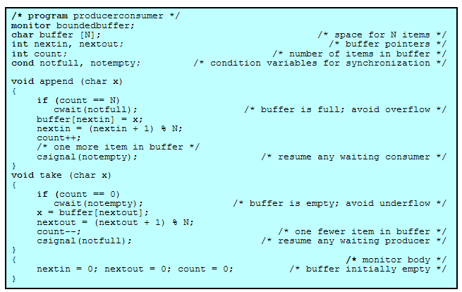
A Solution to the Bounded-Buffer Producer/Consumer Problem Using a Monitor (1/2)

Slide 23
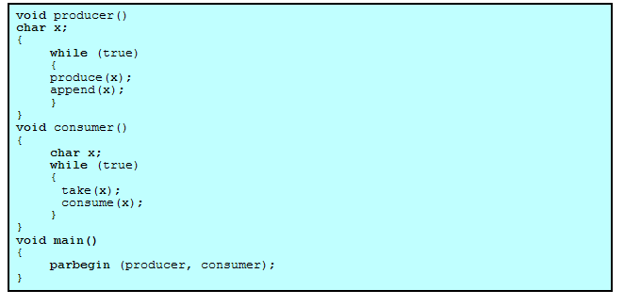
A Solution to the Bounded-Buffer Producer/Consumer Problem Using a Monitor (2/2)
Notes:
a process exits the monitor immediately after executing the csignal function. If the csignal does not occur at the end of the procedure, then, in Hoare’s proposal, the process issuing the signal is blocked to make the monitor available and placed in a queue until the monitor is free. One possibility at this point would be to place the blocked process in the entrance queue, so it would have to compete for access with other processes that had not yet entered the monitor. However, because a process blocked on a csignal function has already partially performed its task in the monitor, it makes sense to give this process precedence over newly entering processes by setting up a separate urgent queue.

Slide 24
Barbershop Problem
void customer ( ) {
enter shop;
sit in barber chair;
leave barber chair;
pay;
exit shop;
}
There are 50 customers, 3 barbers and 1 cashier.
At most 10 customers can stay inside the shop.
Each barber has his own barber chair. A customer goes to sit on a barber chair when the previous customer finishes haircut and leaves the chair.
A barber starts hair cut when a customer sits down.
A customer waits in barber chair until his haircut is finished.
A customer needs to pay before leaving the shop.
void barber ( ) {
while (true) {
cut hair;
}
}
void cashier ( ) {
while (true) {
accept pay;
}
}
This is a simplification of the barbershop problem Appendix A.3 of textbook.

Slide 25
Max capacity of Barbershop
semaphore max_capacity = 10;
void customer ( ) {
wait(max_capacity);
enter shop;
sit in barber chair;
leave barber chair;
pay;
exit shop;
signal(max_capacity); }
At most 10 customers can stay inside the shop.

Slide 26
Sync Customer and Barber – 1
semaphore barber_chair = 3;
semaphore cust_ready = 0, finished = 0;
semaphore leave_b_chair = 0;
void customer ( ) {
…
wait(barber_chair);
sit in barber chair;
signal(cust_ready);
wait(finished);
leave barber chair;
signal(leave_b_chair);
…
void barber ( ) {
while (true) {
wait(cust_ready);
cut hair;
signal(finished);
wait(leave_b_chair);
signal(barber_chair);
} }
A barber starts hair cut when a customer sits down.
A customer waits in barber chair until his haircut is finished.

Slide 27
Sync Customer and Barber – 2
semaphore barber_chair = 3;
semaphore cust_ready = 0, finished = 0;
semaphore leave_b_chair = 0;
void customer ( ) {
…
wait(barber_chair);
sit in barber chair;
signal(cust_ready);
wait(finished);
leave barber chair;
signal(leave_b_chair);
…
void barber ( ) {
while (true) {
wait(cust_ready);
cut hair;
signal(finished);
wait(leave_b_chair);
signal(barber_chair);
} }
Each barber has his own barber chair. A customer goes to sit on a barber chair when the previous customer finishes hair cut and leaves the chair.
Notes:
A customer
that fails to get the processor immediately after his barber executes
semSignal(finished) (i.e., one who falls into a trance or stops to chat with a neighbor) may still be in the chair when the next customer is given the go ahead to be seated. The semaphore leave_b_chair is intended to correct this problem by restraining the barber from inviting a new customer into the chair until the lingering one has announced his departure from it.
The chair should be numbered.

Slide 28
Sync Customer and Cashier
semaphore payment = 0;
semaphore receipt = 0;
void customer ( ) {
...
leave barber chair;
signal(leave_b_chair);
signal(payment);
pay
wait(receipt);
..
void cashier ( ) {
while (true) {
wait(payment);
accept pay;
signal(receipt);
} }
A customer needs to pay before leaving the shop.

Slide 29
Barbershop problem – a solution
void customer ( ) {
wait(max_capacity);
enter shop;
wait(barber_chair);
sit in barber chair
signal(cust_ready);
wait(finished);
leave barber chair;
signal(leave_b_chair);
signal(payment);
pay
wait(receipt);
exit shop;
signal(max_capacity); }
void barber ( ) {
while (true) {
wait(cust_ready);
cut hair;
signal(finished);
wait(leave_b_chair);
signal(barber_chair);
} }
semaphore max_capacity = 10;
semaphore barber_chair = 3;
semaphore cust_ready = 0, finished = 0, leave_b_chair = 0,
payment = 0, receipt = 0;
void main ( ) {
parbegin
customer(); /* 50 times; */
barber(); barber(); barber(); cashier();
parend
}
void cashier ( ) {
while (true) {
wait(payment);
accept pay;
signal(receipt);
} }

Slide 30
Readers/Writers Problem
Readers read the value of shared data.
Writers modify shared data.
No two writers should write at the same time.
When a writer is writing, no readers should read.
When a reader is reading, no writers should write.
Several readers may read at the same time.

Slide 31
Two writers
We learnt how to use critical section to synchronize multiple threads that modify shared data
At any time, only ONE thread can WRITE the resource
/* Writer 1 */ while (true) { wait(s);
WRITE file;
signal(s); }
/* Writer 2 */ while (true) { wait(s);
WRITE file;
signal(s); }
We call the modification operation ‘WRITE’ in this section.

Slide 32
A reader and a writer
A reader reads the value of a resource without modification
The READ and WRITE operation should not be done at the same time (Why?)
/* Writer 1 */ while (true) { wait(s);
WRITE file;
signal(s); }
/* Reader 1 */ while (true) { wait(s);
READ file;
signal(s); }
We call the value retrieval operation ‘READ’ in this section.

Slide 33
Multiple concurrent readers
Because readers don’t modify the value, they can run concurrently.
The simple wait(s) signal(s) pair does not allow this…
The wait(s) and signal(s) pair can prevent concurrent writers and concurrent readers/writers. But it also prevents concurrent readers.
/* Reader 1 */ while (true) { wait(s);
READ file; ⬅
signal(s); }
/* Reader 2 */ while (true) { wait(s); ⬅ z
READ file;
signal(s); }

Slide 34
Readers/Writers Problem
/* in each reader thread */
BeginRead();
<read shared data>
EndRead();
/* in each writer thread */
BeginWrite();
<write shared data>
EndWrite();
We want to design special functions BeginRead(), EndRead(), BeginWrite() and EndWrite() to protect the READ and WRITE operations. These should prevent concurrent writers and concurrent readers/writers, but allow concurrent readers.
R,R,R ✓ W ✓
R,W ✗ W,W ✗

Slide 35
Readers/Writers – A Solution
readcount
0
semaphore x
1
semaphore wsem
1
BeginRead()
/* Reader thread */ while (true) { wait(x);
readcount = readcount + 1;
if (readcount==1) wait(wsem);
signal(x);
READ file;
wait(x);
readcount = readcount - 1;
if (readcount==0) signal(wsem);
signal(x); }
/* Writer thread */ while (true) { wait(wsem);
WRITE file;
signal(wsem); }
EndRead()

Slide 36
Readers/Writers – A Solution
readcount
0
semaphore x
1
semaphore wsem
1
BeginWrite()
/* Reader thread */ while (true) { wait(x);
readcount = readcount + 1;
if (readcount==1) wait(wsem);
signal(x);
READ file;
wait(x);
readcount = readcount - 1;
if (readcount==0) signal(wsem);
signal(x); }
/* Writer thread */ while (true) { wait(wsem);
WRITE file;
signal(wsem); }
EndWrite()

Slide 37
Readers/Writers – solution explained
semaphore wsem
1
/* Reader thread */ while (true) {
wait(wsem);
READ file;
signal(wsem);
}
/* Writer thread */ while (true) { wait(wsem);
WRITE file;
signal(wsem); }
We start the explanation of the Readers/Writers solution with the above code. A single semaphore wsem is used to ensure mutual exclusion of both READs and WRITEs.
This method is too strict. It disallows concurrent readers...

Slide 38
Readers/Writers – solution explained
readcount
0
semaphore wsem
1
/* Reader thread */ while (true) { readcount = readcount + 1;
if (readcount==1) wait(wsem);
READ file;
readcount = readcount - 1;
if (readcount==0) signal(wsem);
}
/* Writer thread */ while (true) { wait(wsem);
WRITE file;
signal(wsem); }
To allow concurrent readers, only the first coming reader executes wait(wsem), while others just pass through. Similarly, only the last leaving reader executes signal(wsem) to wake up any blocked writers.

Slide 39
Readers/Writers – solution explained
readcount
0
semaphore x
1
semaphore wsem
1
/* Reader thread */ while (true) { wait(x);
readcount = readcount + 1;
if (readcount==1) wait(wsem);
signal(x);
READ file;
wait(x);
readcount = readcount - 1;
if (readcount==0) signal(wsem);
signal(x); }
/* Writer thread */ while (true) {
But, multiple readers may try to read and modify the shared variable readcount. We protect this critical section using another semaphore x.

Slide 40
Readers/Writers – solution explained
readcount
0
semaphore x
1
semaphore wsem
1
The first coming reader is responsible to call wait(wsem). If he is blocked, then all other readers will be blocked at 
/* Reader thread */ while (true) { wait(x); 
readcount = readcount + 1;
if (readcount==1) wait(wsem);
signal(x);
READ file;
wait(x);
readcount = readcount - 1;
if (readcount==0) signal(wsem);
signal(x); }
The last leaving reader is responsible to call signal(wsem) to wake up writer

Slide 41
Readers/Writers – A Solution
readcount
0
semaphore x
1
semaphore wsem
1
/* Reader thread */ while (true) { wait(x);
readcount = readcount + 1;
if (readcount==1) wait(wsem);
signal(x);
READ file;
wait(x);
readcount = readcount - 1;
if (readcount==0) signal(wsem);
signal(x); }
/* Writer thread */ while (true) { wait(wsem);
WRITE file;
signal(wsem); }

Slide 42
Readers/Writers Example (1/12)
rc
0
x
1
wsem
1
/* Reader thread */ while (true) {
… ⬅R1 ⬅R2
wait(x);
rc = rc + 1;
if (rc==1) wait(wsem);
signal(x);
READ file;
wait(x);
rc = rc -1;
if (rc==0) signal(wsem);
signal(x); }
/* Writer thread */ while (true) {
…⬅W1
wait(wsem);
WRITE file;
signal(wsem); }
a1 a2 a3 a4 a5
a6
a7
a8
a9
b1 b2 b3
⬅
Running/ready
⬅ z
Blocked at the instruction wait()

Slide 43
Readers/Writers Example (2/12)
rc
1
x
0
wsem
0
/* Reader thread */ while (true) {
… ⬅R2
wait(x);
rc = rc + 1;
if (rc==1) wait(wsem); ⬅R1
signal(x);
READ file;
wait(x);
rc = rc -1;
if (rc==0) signal(wsem);
signal(x); }
/* Writer thread */ while (true) {
…⬅W1
wait(wsem);
WRITE file;
signal(wsem); }
a1 a2 a3 a4 a5
a6
a7
a8
a9
b1 b2 b3
Suppose R1 is dispatched first. He is the first reader and will wait(wsem) which sets wsem=0. This prevents any writers from entering while there are some readers reading the file.

Slide 44
Readers/Writers Example (3/12)
rc
1
x
1
wsem
0
/* Reader thread */ while (true) {
… ⬅R2
wait(x);
rc = rc + 1;
if (rc==1) wait(wsem);
signal(x);
READ file; ⬅R1
wait(x);
rc = rc -1;
if (rc==0) signal(wsem);
signal(x); }
/* Writer thread */ while (true) {
…⬅W1
wait(wsem);
WRITE file;
signal(wsem); }
a1 a2 a3 a4 a5
a6
a7
a8
a9
b1 b2 b3
R1 passes through and starts reading file.

Slide 45
Readers/Writers Example (4/12)
rc
1
x
1
wsem
-1
/* Reader thread */ while (true) {
… ⬅R2
wait(x);
rc = rc + 1;
if (rc==1) wait(wsem);
signal(x);
READ file; ⬅R1
wait(x);
rc = rc -1;
if (rc==0) signal(wsem);
signal(x); }
/* Writer thread */ while (true) {
…
wait(wsem); ⬅ z W1
WRITE file;
signal(wsem); }
a1 a2 a3 a4 a5
a6
a7
a8
a9
b1 b2 b3
If W1 runs now, he will be blocked. Someone is reading the file, so he cannot start writing yet.

Slide 46
Readers/Writers Example (5/12)
rc
2
x
1
wsem
-1
/* Reader thread */ while (true) {
…
wait(x);
rc = rc + 1;
if (rc==1) wait(wsem);
signal(x);
READ file; ⬅R1 ⬅R2
wait(x);
rc = rc -1;
if (rc==0) signal(wsem);
signal(x); }
/* Writer thread */ while (true) {
…
wait(wsem); ⬅ z W1
WRITE file;
signal(wsem); }
a1 a2 a3 a4 a5
a6
a7
a8
a9
b1 b2 b3
But other readers can still start reading.

Slide 47
Readers/Writers Example (6/12)
rc
1
x
1
wsem
-1
/* Reader thread */ while (true) {
…
wait(x);
rc = rc + 1;
if (rc==1) wait(wsem);
signal(x);
READ file; ⬅R2
wait(x);
rc = rc -1;
if (rc==0) signal(wsem);
signal(x); } ⬅R1
/* Writer thread */ while (true) {
…
wait(wsem); ⬅ z W1
WRITE file;
signal(wsem); }
a1 a2 a3 a4 a5
a6
a7
a8
a9
b1 b2 b3
After R1 finishes reading the file …

Slide 48
Readers/Writers Example (7/12)
rc
0
x
0
wsem
0
/* Reader thread */ while (true) {
…
wait(x);
rc = rc + 1;
if (rc==1) wait(wsem);
signal(x);
READ file;
wait(x);
rc = rc -1;
if (rc==0) signal(wsem); ⬅R2
signal(x); } ⬅R1
/* Writer thread */ while (true) {
…
wait(wsem);
WRITE file; ⬅W1
signal(wsem); }
a1 a2 a3 a4 a5
a6
a7
a8
a9
b1 b2 b3
When R2 (the last reader) finishes reading, he will wake up a waiting writer (in this case, W1) by signal(wsem).

Slide 49
Slide |  |  | rc | x | wsem
1 |  |  | 0 | 1 | 1
2 | R1 | A1 |  | 0
 |  | A2 | 1
 |  | A3 |  |  | 0
3 |  | A4 |  | 1
 |  | A5 |  |  |  | Read file
4 | W1 | B1 |  |  | -1 | Blocked
5 | R2 | A1-A5 | 2 | 1 | -1 | Read file
6 | R1 | A6-A9 | 1 | 1 | -1
7 | R2 | A6-A7 | 0 | 0 | -1
 |  | A8 |  |  | 0 | Wake up W1
 |  | A9 | 0 | 1 | 0
 | W1 | B2 |  |  |  | Write file

Slide 50
Readers/Writers Example (8/12)
rc
0
x
1
wsem
0
/* Reader thread */ while (true) {
… ⬅R1 ⬅R2
wait(x);
rc = rc + 1;
if (rc==1) wait(wsem);
signal(x);
READ file;
wait(x);
rc = rc -1;
if (rc==0) signal(wsem);
signal(x); }
/* Writer thread */ while (true) {
… ⬅W2
wait(wsem);
WRITE file; ⬅W1
signal(wsem); }
a1 a2 a3 a4 a5
a6
a7
a8
a9
b1 b2 b3
Now we consider the case that when a writer is writing, some readers and another writer want to enter.

Slide 51
Readers/Writers Example (9/12)
rc
1
x
0
wsem
-1
/* Reader thread */ while (true) {
… ⬅R2
wait(x);
rc = rc + 1;
if (rc==1) wait(wsem);⬅z R1
signal(x);
READ file;
wait(x);
rc = rc -1;
if (rc==0) signal(wsem);
signal(x); }
/* Writer thread */ while (true) {
… ⬅W2
wait(wsem);
WRITE file; ⬅W1
signal(wsem); }
a1 a2 a3 a4 a5
a6
a7
a8
a9
b1 b2 b3
The first reader will be blocked here..

Slide 52
Readers/Writers Example (10/12)
rc
1
x
-1
wsem
-1
/* Reader thread */ while (true) {
…
wait(x); ⬅z R2
rc = rc + 1;
if (rc==1) wait(wsem);⬅z R1
signal(x);
READ file;
wait(x);
rc = rc -1;
if (rc==0) signal(wsem);
signal(x); }
/* Writer thread */ while (true) {
… ⬅W2
wait(wsem);
WRITE file; ⬅W1
signal(wsem); }
a1 a2 a3 a4 a5
a6
a7
a8
a9
b1 b2 b3
And other readers will be blocked here…

Slide 53
Readers/Writers Example (11/12)
rc
1
x
-1
wsem
-2
/* Reader thread */ while (true) {
…
wait(x); ⬅z R2
rc = rc + 1;
if (rc==1) wait(wsem);⬅z R1
signal(x);
READ file;
wait(x);
rc = rc -1;
if (rc==0) signal(wsem);
signal(x); }
/* Writer thread */ while (true) {
…
wait(wsem); ⬅z W2
WRITE file; ⬅W1
signal(wsem); }
a1 a2 a3 a4 a5
a6
a7
a8
a9
b1 b2 b3
Other writers will be blocked also.

Slide 54
Readers/Writers Example (12/12)
rc
1
x
-1
wsem
-2
/* Reader thread */ while (true) {
…
wait(x); ⬅z R2
rc = rc + 1;
if (rc==1) wait(wsem);⬅z R1
signal(x);
READ file;
wait(x);
rc = rc -1;
if (rc==0) signal(wsem);
signal(x); }
/* Writer thread */ while (true) {
…
wait(wsem); ⬅z W2
WRITE file; ⬅W1
signal(wsem); }
a1 a2 a3 a4 a5
a6
a7
a8
a9
b1 b2 b3
Exercise: What happens when W1 finishes writing and execute signal(wsem)?

Slide 55
Slide |  |  | rc | x | wsem
 |  |  | 0 | 1 | 1
8 | W1 | B1 |  |  | 0
 |  | B2 |  |  |  | Write file
9 | R1 | A1 |  | 0
 |  | A2 | 1
 |  | A3 |  |  | -1 | Blocked
10 | R2 | A1 |  | -1 |  | Blocked
11 | W2 | B1 |  |  | -2 | Blocked
12 | W1 | B3 |  |  | -1 | Wake up who?

Slide 56
Dining Philosophers Problem
Philosopher 2
void philosopher (int i) {
while (true) {
think; grab my left and right forks;
eat;
release the two forks;
}
}
Fork 3
Fork 2
Philosopher 3
Philosopher 1
Each philosopher thinks for a while. Then he is hungry and tries to grab his left and right fork. If he succeeds, he starts eating. Otherwise, he has to wait (starve). After eating, he will release the two forks for other philosophers to use.
Fork 4
Fork 1
Fork 0
Philosopher 4
Philosopher 0

Slide 57
Using Semaphore to Control Resource Access
fork[0]=1 means the fork is available. A philosopher grabs it by wait(fork[0]). If the fork is available, fork[0] becomes 0 and the philosopher continues. Otherwise, he is blocked, waiting for another philosopher to free the fork by signal(fork[0]).
Semaphore fork[5]
1
1
1
1
1
void philosopher0 ( ) {
while (true) {
think; wait(fork[0]);
wait(fork[1]);
eat;
signal(fork[1]);
signal(fork[0]);
}
}
void philosopher1 ( ) {
while (true) {
think; wait(fork[1]);
wait(fork[2]);
eat;
signal(fork[2]);
signal(fork[1]);
}
}
void philosopher4 ( ) {
while (true) {
think; wait(fork[4]);
wait(fork[0]);
eat;
signal(fork[0]);
signal(fork[4]);
}
}

Slide 58
A First Solution
Semaphore fork[5]
1
1
1
1
1
void philosopher (int i) {
while (true) {
think; wait(fork[i]); /* left fork */
wait(fork[(i+1) % 5]); /* right fork */
eat;
signal(fork[(i+1) % 5]); /* right fork */
signal(fork[i]); /* left fork */
}
}
Five threads
Philosopher(0)
Philosopher(1)
Philosopher(2)
Philosopher(3)
Philosopher(4)

Slide 59
Circular Wait and Deadlock
Deadlock occurs in the previous solution when there is a circular wait.
If each philosopher grabs his left fork at the same time, and then tries to grab his right fork, nobody is able to get both forks. Phil 0 waits for phil 1 to release fork 1, phil 1 waits for phil 2, … phil 4 waits for phil 0. All five philosophers will be blocked forever.

Slide 60
A Second Solution
semaphore fork[5]
1
1
1
1
1
semaphore room
4
void philosopher (int i) {
while (true) {
think;
wait(room); wait(fork[i]); /* left fork */
wait(fork[(i+1) % 5]); /* right fork */
eat;
signal(fork[(i+1) % 5]); /* right fork */
signal(fork[i]); /* left fork */
signal(room);
}
}
At most 4 philosophers are allowed to enter the room.
No circular wait, and no deadlock.

Slide 61

Conclusion
Critical section
What is it? How to protect?
Synchronization
Semaphore, as communication between threads
Monitor
Reference
The synchronized keyword, java.util.concurrent package
The Little Book of Semaphores http://greenteapress.com/semaphores/

Slide 62

Next Topic
Memory Management
Read Ch. 7

